Slide 1


PCD : PRINCIPALS OF COMPILER DESIGN
Syntax Analysis Parsing
Department of IT
Unit no : 1 Parsing
FACULTY:
MS.G.VIDYASREE

Slide 2
Outline :
Department of IT
Unit no : 1 Parsing
Role of parser
Parse tree
Classification of grammar Derivation and Reduction Ambiguous grammar
Left Recursion Left Factoring
Top-down Bottom-up parsing
LR Parsers – LR(0), SLR, CLR , LALR

Slide 3
🞄 In our compiler model, the parser obtains a string of tokens from the lexical analyzer and verifies that the string of token names can be generated by the grammar for the source language.
Role of Parser
🞄 It reports any syntax errors in the program. It also recovers from commonly occurring errors so that it can continue processing its input.

Slide 4
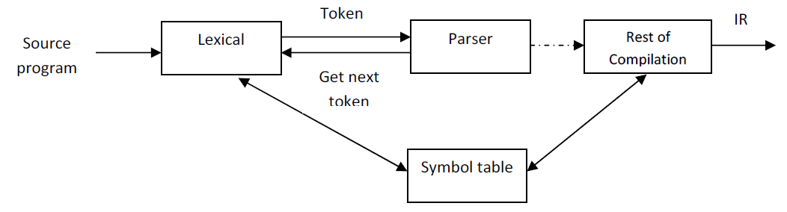
Scanner – Parser Interaction
Parse Tree
🞄 For well-formed programs, the parser constructs a parse tree and passes it to the rest of the compiler for further processing.

Slide 5
🞄 If a compiler had to process only correct programs, its design and implementation would be greatly simplified.
Syntax Error Handling
🞄 But programmers frequently write incorrect programs, and a good compiler should assist the programmer in identifying and locating errors.
🞄 We know that programs can contain errors at many
different levels. For example, errors can be
🞄 Lexical : Such a misspelling an identifier, keyword, or operator
🞄 Syntactic : Such as arithmetic expression with
unbalanced parenthesis
🞄 Semantic : Such as an operator
incompatible operand
🞄 Logical : Such as infinitely recursive call
applied to

Slide 6
🞄 It should report the presence of errors clearly and
Syntax Error Handling
🞄 The error handler in a parser has simple-to-state goals :
accurately.
🞄 It should recover from each error quickly enough to be able to detect sub sequent errors.
🞄 It should not significantly slow down the processing of correct programs.

Slide 7
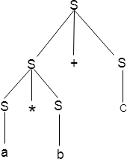
🞄 Parse tree is graphical representation of symbol.
Parse tree
Symbol can be terminal as well as non-terminal.
🞄 The root of parse tree is start symbol of the string.
🞄 Parse tree follows the precedence of operators. The deepest sub-tree traversed first. So, the operator in the parent node has less precedence over the operator in the sub-tree.
🞄 Example:-

Slide 8
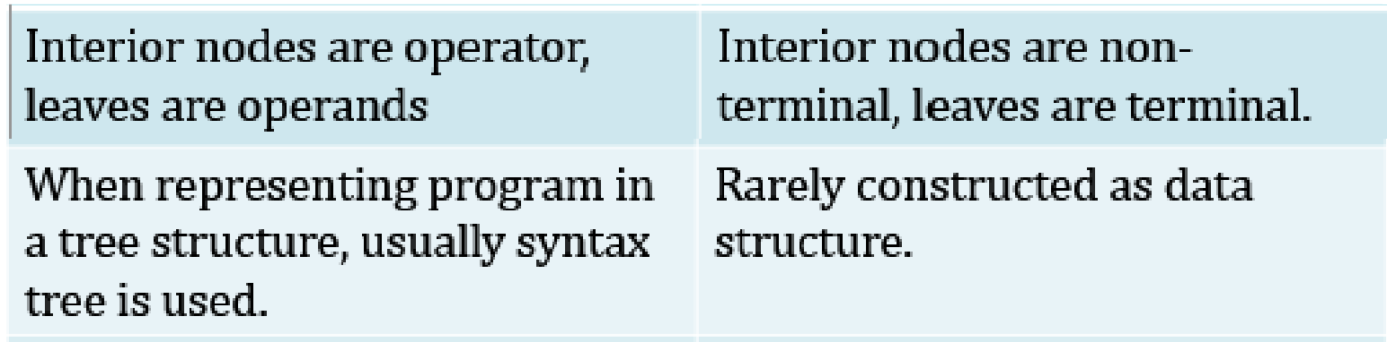
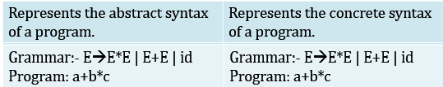
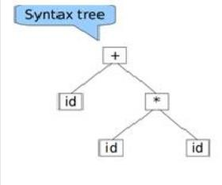
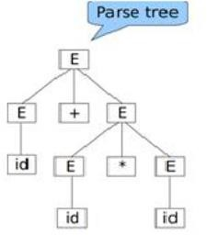
Syntax tree | Parse tree
Parse tree V/S
Syntax tree

Slide 9
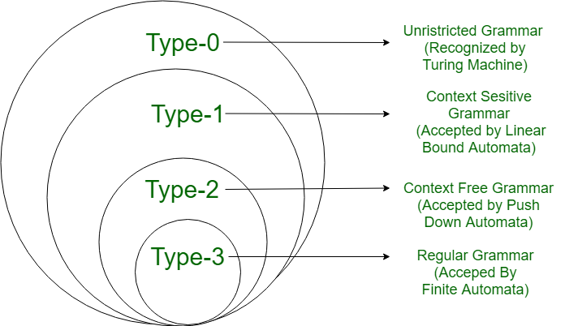
CONTEXT-FREE GRAMMAR(CFG)
Noam Chomsky generalized languages in 1956
Chomsky hierarchy of Language

Slide 10
🞄 Given below are class of grammar where each class has its own
🞄 Grammars are classified on the basis of production they use (Chomsky, 1963).
Classification of Grammar
characteristics and limitations.
Type-0 Grammar:- Recursively Enumerable Grammar
🞄 These grammars are known as phrase structure grammars.
Their productions are of the form,
🞄 α = β, where both α and β are terminal and non-terminal symbols.
🞄 This type of grammar is not relevant to Specifications of programming languages.
Type-1 Grammar:- Context Sensitive Grammar
🞄 These Grammars have rules of the form αAβ → αΥβ with A nonterminal and α, β, Υ strings of terminal and nonterminal symbols. The string α and β may be empty but Υ must not be nonempty.
🞄 Eg:- AB->CDB
Ab->Cdb
A->b

Slide 11
3. Type-2 Grammar:- Context Free Grammar
Classification of Grammar
🞄 These are defined by the rules of the form A → Υ, with A nonterminal and Υ a sting of terminal and nonterminal Symbols. These grammar can be applied independent of its context so it is Context free Grammar (CFG). CFGs are ideally suited for programming language specification.
🞄 Eg:- A → aBc
4. Type-3 Grammar:- Regular Grammar
🞄 It restrict its rule of single nonterminal on the left hand side and a right-hand side consisting of a single terminal, possibly followed by a single nonterminal. The rule S → ϵ is also allowed if S does not appear on the right side of any rule.
🞄 Eg:- A → ϵ
A → a A → aB

Slide 12
🞄 Let production P₁ of grammar G be of the form P₁ : A::= α
Derivation
and let β be a string such that β = γAθ, then replacement of A by α in string β constitutes a derivation according to production P₁.
Example
<Sentence> ::= <Noun Phrase><Verb Phrase>
<Noun Phrase> ::= <Article> <Noun>
<Verb Phrase> ::= <Verb><Noun Phrase>
<Article> ::= a | an | the
<Noun> ::= boy | apple
<Verb> ::= ate

Slide 13
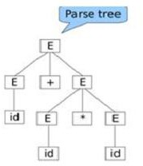
Derivation
🞄 The following strings are sentential form.
<Sentence>
<Noun Phrase> <Verb Phrase>
<article> <noun> <Verb Phrase> the boy <Verb Phrase>
the boy <verb> <Noun Phrase> the boy ate <Noun Phrase>
the boy ate <article> <noun>
the boy ate an apple String : id + id * id

Slide 14
🞄 The process of deriving string is called Derivation and graphical representation of derivation is called derivation tree or parse tree.
Derivation
🞄 Derivation is a sequence of a production rules, to get the input string.
🞄 During parsing we take two decisions:
Deciding the non terminal which is to be replaced.
Deciding the production rule by which non terminal will be replaced.
For this we are having:
Left most derivation
Right most derivation

Slide 15
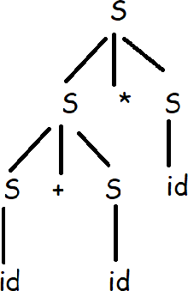
Left Derivation
🞄 A derivation of a string S in a grammar G is a left most
derivation if at every step the left most non terminal is replaced.
Example:
🞄 Production:
S→ S + S
S→ S * S
S→ id
🞄 String:- id+id*id
S→ S * S
S→S + S * S
S→ id + S * S S→ id + id * S
S→ id + id * id

Slide 16
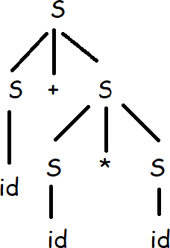
Right Derivation
🞄 A derivation of a string S in a grammar G is a right most
derivation if at every step the Right most non terminal is replaced.
Example:
🞄 Production:
S→ S + S
S→ S * S
S→ id
🞄 String:- id+id*id
S→ S + S
S→S + S * S
S→ S + S * id S→ S + id * id
S→ id + id * id

Slide 17
Let production P₁ of grammar G be of the form P₁ : A::= α
Reduction
and let σ be a string such that σ = γ α θ, then replacement of α by A in string σ constitutes a reduction according to production P₁.
Step | String
0 | the boy ate an apple
1 | <Article> boy ate an apple
2 | <Article> <Noun> ate an apple
3 | <Article> <Noun> <Verb> an apple
4 | <Article> <Noun> <Verb> <Article> apple
5 | <Article> <Noun> <Verb> <Article> <Noun>
6 | <Noun Phrase> <Verb> <Article> <Noun>
7 | <Noun Phrase> <Verb> <Noun Phrase>
8 | <Noun Phrase> <Verb Phrase>
9 | <Sentence>

Slide 18
It implies the possibility of different interpretation of a source string.
Ambiguous Grammar
Existence of ambiguity at the level of the syntactic
structure of a string would mean that more than one parse
tree can be built for the string. So string can have more
than one meaning associated with it.
A grammar that produces more than one parse tree for some sentence is said to be ambiguous.
Ambiguous Grammar
E → Id| E + E | E * E Id → a | b | c
a + b * c
+
a + b * c
*
a
+
c
*
Both tree have same string : a + b * c
b
c
a
b

Slide 19
E→ E + E | E * E | id By parse tree:-
E
Ambiguous Grammar
E + E
Parse tree-1
id
E * E
id
id
E
E * E
Parse tree-2
E + E id
id
id

Slide 20
🞄 Prove that given grammar is ambiguous grammar:
Ambiguous Grammar Example:-
🞄 E→ a | Ea | bEE | EEb | EbE Ans:-
Assume string baaab E→ bEE
baE
baEEb baaEb baaab
Left derivation-1
OR
E→ EEb
bEEEb baEEb baaEb baaab
Left derivation-2

Slide 21
Check whether given grammar is ambiguous or not?
🞄 S → A / B
🞄 A → aAb / ab
🞄 B → abB / ∈

Slide 22
Check whether given grammar is ambiguous or not?
🞄 S → SS | a | b

Slide 23
🞄 In leftmost derivation by scanning the input from left to right, grammars of the form A → A x may cause endless recursion.
Left Recursion
🞄 Such grammars are called left-recursive and they must be transformed if we want to use a top-down parser.
🞄 Example:
E→ Ea | E+b | c

Slide 24
Algorithm
🞄 Assign an ordering from A1,…….An to the non terminal of the grammar;
🞄 For i = 1 to n do
begin
for j=1 to i-1 do begin
replace each production of the form Ai → AiΥ
by the productions Ai → δ1Υ | δ2Υ |…… | δkΥ where Aj → δ1 | δ2 |……….. | δk are all current
Aj production.
end
eliminate the intermediate left recursion among Ai productions.
end

Slide 25
Left Recursion
There are three types of left recursion:
direct (A → A x)
indirect (A → B C, B → A )
hidden (A → B A, B → ε)
To eliminate direct left recursion replace
A → Aα₁ | Aα₂ | ... | Aα_{m} | β₁ | β₂ | ... | β_{n}
with
A → β₁ A’ | β₂ A’ | ... | β_{n} A’
A’ → α₁ A’ | α₂ A’ | ... | α_{m} A’ | ε

Slide 26
1. E → E + T | T
T→ T * F | F F → (E) | id
Example
Ans.
A → Aα | β
Replace with,
A → β A’
A’ → α A’ | ε
E → TE’
E’ → +TE’ | ε
T → FT’
T’ → *FT’ | ε
F → (E) | id

Slide 27
Remove left recursion
Example
1. A → Aad | Afg | b Ans:-
A→ bA’
A’ → adA’ | fgA’ | ε
2. A→ Acd | Ab | jk B→ Bh | n
Ans :-
Remove left recursion
A→ jkA’
A’ → cdA’ | bA’ | ε
B → nB’
B’ → hB’ | ε

Slide 28
A → Ac | Ed | ε
Example
3. E → Aa | b
Ans:-
Replace E,
E→ Aa | b
A → Ac | Aad | bd | ε
Remove left recursion
E→ Aa | b
A → bdA’ | A’
A → cA’ | adA’ | ε

Slide 29
for producing a grammar suitable for predictive parsing.
🞄 Left factoring is a grammar transformation that is useful
Left Factoring
🞄 Consider,
🞄 S → if E then S else S | if E then S
🞄 Which of the two productions should we use to expand non-terminal S when the next token is if?
🞄 We can solve this problem by factoring out the common part in these rules. This way, we are postponing the decision about which rule to choose until we have more information (namely, whether there is an else or not).
🞄 This is called left factoring

Slide 30
🞄 For each non terminal A find the longest prefix α common to two or more of its alternative.
🞄 If α!=E, i.e, there is a non trivial common prefix, replace all the A productions A→ αβ1 | αβ2 | ….. | αβn | Υ ,
where Υ represents all the alternative which do not starts with α by,
A→ αA’ | Υ
A’→ β1 | β2 |…… | βn
Here, A’ is new non terminal, repeatedly apply this transformation until no two alternatives for a non-terminal have a common prefix.
Algorithm

Slide 31
A → αβ₁ | αβ₂ |...| αβ_{n} | γ
Left Factoring
becomes
A → α A”| γ
A” → β₁ | β₂ |...| β
n

Slide 32
E -> T+E | T T -> V*T | V
Example
V-> id
Ans. E→ TE’
E’ → +E | ε
T→ VT’
T’ → *T | ε
V → id

Slide 33
Example
1. S → cdLk | cdk | cd L→ mn | ε
Ans.
S→ cdS’
S’ → Lk | k | ε
L→ mn | ε
2. E → iEtE | iEtEeE | a A→b
Ans.
E → iEtEE’ | a E’ → ε | eE
A → b

Slide 34
Example :
Compute First
A → bcg | gh FIRST(A) = {b, g}
A → Bcd | gh
B → m | ε
FIRST(A) = {m, c , g}
FIRST(B) = {m , ε}

Slide 35
A → BCD | Cx
Compute First
Example :
B → b | ε
C → c | ε
D → d | ε
FIRST(A) = {b, c, d, x, ε} FIRST(B) = {b, ε}
FIRST(C) = {c , ε}
FIRST(D) = {d , ε}

Slide 36
Example : S → PQr | s
Compute First
P → Abc | ε
Q → d | ε
A → a| ε
A → mn | Xy | Z X → x | ε
Z → ε

Slide 37
A → bcg | gh
Compute Follow
Example :
FOLLOW(A) = {$}
A → Bcd | gh
B → mA | ε
FOLLOW(A) = {$, c}
FOLLOW(B) = {c}

Slide 38
A → BCD | Cx
Compute Follow
Example :
B → b | ε
C → c | ε
D → d | ε

Slide 39
Parser
Parser
Top Down
Parser
Bottom Up
Parser
With Backtracking
Without
Backtracking
Operator Precedence Parser
LR Parser
LR(0)
Recursive
Descent
Predictive Parser
CLR(1)
SLR(1)
LL(1) Parser
LALR(1)

Slide 40
🞄 Top-down parser is the parser which generates parse tree for the given input string with the help of grammar productions by expanding the non-terminals i.e. it starts from the start symbol and ends on the terminals.
Top down parser
🞄 It works as following:
🞄 Start with the root or start symbol.
🞄 Grow the tree downwards by expanding productions at the lower levels of the tree.
🞄 Select a nonterminal and extend it by adding children corresponding to the right side of some production for the nonterminal.
🞄 Repeat till, Lower fringe consists only terminals and the input is consumed Top-down parsing basically finds a leftmost derivation for an input string.

Slide 41
 | SSM |  |  | Prediction |  | String
E | 1 |  |  | -- |  | <id>+<id>*<id>
T+E | 1 |  |  | E→ T+E |  | <id>+<id>*<id>
V*T+E | 1 |  |  | T→V*T |  | <id>+<id>*<id>
<id>*T+E | 1 2 |  |  | V→<id> |  | <id>+<id>*<id>
V+E | 1 |  |  |  | T→V | <id>+<id>*<id>
<id>+E | 1 2 3 |  |  |  | V→<id> | <id>+<id>*<id>
<id>+T+E |  | 3 |  | E→T+E |  | <id>+<id>*<id>
<id>+V*T+E |  | 3 |  | T→V*T |  | <id>+<id>*<id>
<id>+<id>*T+E |  | 3 4 5 |  | V→<id> |  | <id>+<id>*<id>
<id>+<id>*V*T+E 5 <id>+<id>*<id>*T+E 5 |  |  |  | T→V*T V→<id> |  | <id>+<id>*<id> <id>+<id>*<id>
<id>+T |  |  | 3 | E→T |  | <id>+<id>*<id>
<id>+V*T |  |  | 3 | T→V*T |  | <id>+<id>*<id>
Top down parser with backtracking
Example:
E→ T + E | T
T→ V * T | V
V→ <id>
I/p string is:
<id> + <id> * <id>
<id>+<id>*T
<id>+<id>*V*T
<id>+<id>*<id>*T
<id>+<id>*V
<id>+<id>*<id>
3 4 5
5
5
5
5
V→<id> T→V*T V→<id> T→V V→<id>
<id>+<id>*<id>
<id>+<id>*<id>
<id>+<id>*<id>
<id>+<id>*<id>
<id>+<id>*<id>

Slide 42
CSF | Symbol | Prediction
E | <id> | E→ TE’
TE’ | <id> | T→ VT’
VT’E’ | <id> | V→<id>
<id>T’E’ | + | T’→ε
<id>E’ | + | E’→+E
<id>+E | <id> | E→TE’
<id>+TE’ | <id> | T→VT’
<id>+VT’E’ | <id> | V→<id>
<id>+<id>T’E’ | * | T’→*T
<id>+<id>*TE’ | <id> | T→VT’
<id>+<id>*VT’E’ | <id> | V→<id>
<id>+<id>*<id>T’E’ | -- | T’→ε
<id>+<id>*<id>E’ | -- | E’→ε
<id>+<id>*<id> | -- | --
Top down parser without backtracking
Example:
E→ T + E | T
T→ V * T | V V→ <id>
E→ TE’
E’→ +E | ε
T → VT’
T’→ *T | ε
V→ <id>
I/p string is:
<id> + <id> * <id>

Slide 43
Recursive Descent Parser
🞄 A Recursive Descent Parser is a variant of top down parsing.
🞄 It may involve backtracking.
🞄 Top down parsing can be viewed as an attempt to find a left most derivation for an input string.
🞄 Equivalently, it can be viewed as an attempt to construct a parse tree for the input starting from the root and creating the nodes of the parse tree in preorder.
🞄 Silent advantages of RDP are its simplicity and generality.

Slide 44
S → cAd A → ab | a
String : cad
Recursive Descent Parser
S
S
S
c A d
c A d
c A d
a
b
a

Slide 45
Recursive Descent Parser
🞄 Advantages:
They are exceptionally simple
They can be constructed from recognizers simply by doing some extra work specifically, building a parse tree
🞄 Disadvantages:
Not very fast.
It is difficult to provide really good error messages
They cannot do parses that require arbitrarily lookaheads
long

Slide 46
🞄 Special case of Recursive descent parser is called Predictive parser.
Predictive Parser
🞄 In Many cases, by carefully writing a grammar, eliminating left recursion from it, and left factoring the resulting grammar, we can obtain a grammar that can be parsed by a recursive descent parser that needs no backtracking i.e. Predictive parser.
stmt → if expr then stmt else stmt
| while expr do stmt
| begin stmt_list end
🞄 The keywords if, while and begin tell us which alternative is the only one that could possibly succeed if we are to find a statement.

Slide 47
INPUT STRING
Non Recursive Predictive parsing
 | a | + | b | $
X
Y
Z
$
Predictive Parsing Program
OUTPUT
STACK
Parsing Table M[X,a]

Slide 48
1) If X = a = $, the parser halts and announces successful
Non Recursive Predictive parsing
🞄 The parser works as follow:
completion of parsing
2) If X = a ≠ $ , the parser pops X off the stack and advance input pointer to the next input symbol.
3) If X is Non terminal, the program consults entry M[X,a] of parsing Table M. This entry will be either X- production of grammar or an error entry.
For eg : M [X,a] = { X → U V W },
The parser replace X on top of stack by WVU (With U on top).
If M[X,a] = Error
The Parser Calls an error recovery routine.

Slide 49
🞄 L stands for left-to-right scanning, L stands for Left most derivation and ‘1’ in LL(1) indicates that the grammar uses a look-ahead of one source symbol – that is, the prediction to be made is determined by the next source symbol.
LL(1) Parser or Predictive parsing
🞄 An LL(1) parser is a table driven parser.
🞄 A major advantage of LL(1) parsing is its amenability to automatic construction by a parser generator.
🞄 The data structure used by this parser are input
buffer, stack and parsing table.

Slide 50
I. Remove left recursion.
LL(1) Parser or Predictive parsing
🞄 Steps to construct LL(1)
II. Compute first and follow of non terminal.
III. Construct predictive parsing table.
IV. Parse the input string with the help of parsing
table.

Slide 51
LL(1) Parser Example:
E→ E + T | T
T→ T * F | F F→ id | (E)
🞄 Step 1:- Remove Left Recursion
E→ TE’
E’→ +TE’ | ε
T → FT’
T’→ *FT’ | ε
F→ id | (E)

Slide 52
Step 1:- Remove Left Recursion
E→ TE’
E’→ +TE’ | ε
T → FT’
T’→ *FT’ | ε
F→ (E) | id
LL(1) Parser Example:
E→ E + T | T
T→ T * F | F F→ (E) | id
Step 2:- FIRST and FOLLOW
 | FIRST | FOLLOW
E | {(, id} | {$,)}
E’ | {+, ε} | {$,)}
T | {(, id} | { +, $, )}
T’ | {*, ε} | {+, $,)}
F | {(, id} | {*, +, $, )}

Slide 53
LL(1) Parser Example:
Step 3: Predictive parsing table
 | id | * | + | ( | ) | $
E | E→TE’ |  |  | E→TE’
E’ |  |  | E’→+TE’ |  | E’→ε | E’→ε
T | T→FT’ |  |  | T→FT’
T’ |  | T’ →*FT’ | T’→ε |  | T’ →ε | T’→ε
F | F→id |  |  | F→(E)
id
*
+
(
)
$
E
E→ E + T | T
T→ T * F | F F→ (E) | id
E’
T
T’
F

Slide 54
Step 4: Predictive parsing table
Stack $E | Input id+id*id$ | Action
$E’T | id+id*id$ | E→TE’
$E’T’F | id+id*id$ | T→FT’
$E’T’id | id+id*id$ | F→id
$E’T’ $E’ | +id*id$ +id*id$ | T’→ ε
$E’T+ | +id*id$ | E’→+TE’
$E’T | id*id$
$E’T’F | id*id$ | T→FT’
$E’T’id | id*id$ | F→id
$E’T’ | *id$
$E’T’F* | *id$ | T’→*FT’
$E’T’F | id$
$E’T’id | id$ | F→id
$E’T’ $E’ | $ $ | T’→ε
$ | $ | E’→ε
LL(1) Parser Example:
E→ E + T | T
T→ T * F | F F→ (E) | id

Slide 55
1. S→ 1AB | ε A→ 1AC | 0C B→ 0S
LL(1) Parser Example:
Check whether given grammar is LL(1) or not?
C→ 1
2. S→ iEtSS’ | a
S’→ eS | ε
E → b

Slide 56
Transition Diagram for Predictive Parser
T
E’
E :
0
1
22
+
T
E’
E’ :
3
4
5
61
ε
F
T’
T :
7
8
92
*
F
T’
T’ :
10
11
12
12 3
ε
(
E
)
F :
14
15
16
1²7
id

Slide 57


ε
T
Transition Diagram for Predictive Parser
+
T
+
E’ :
3
4
5
3
4
E’ :
ε
62
ε
62
T
+
T
+
T
E :
0
3
4
E :
0
3
ε
ε
62
62

Slide 58
Transition Diagram for Predictive Parser
+
T
ε
E :
0
3
64
*
F
ε
T :
7
8
14 3
(
E
)
F :
14
15
16
1²7
id

Slide 59
🞄 Handle:- A handle of a string is a substring of the string that matches the right side of a production, and we can reduce such string by a non terminal on left hand side production.
Handle and Handle Pruning
🞄 Handle Pruning:- The process of discovering a handle and reducing it to appropriate left hand side non terminal is known as handle pruning.
Right sentential form | Handle | Reducing Production | E -> E + E E -> E * E E -> id id + id == >string | v E + id (id is handle) E + E (id is handle) E (E+E is handle)
id1+id2*id3 | Id1 | E→id
E+id2*id3 | Id2 | E→id
E+E*id | Id3 | E→id
E+E*E | E*E | E→E*E
E+E | E+E | E→E+E
E

Slide 60
Shift Reduce Parsing
Attempts to construct a parse tree for an input string beginning at the leaves (bottom) and working up towards the root (top).
“Reducing” a string w to the start symbol of a grammar.
At each step, decide on some substring that matches the RHS of some production.
Replace this string by the LHS (called reduction).

Slide 61
1. Shift:- Moving of the symbols from input buffer onto the stack, this action is called shift.
Shift Reduce Parsing
🞄 It has following operations:
Reduce:- If the handle appears on the top of the stack then reduction of it by appropriate rule is done. That means R.H.S of the rule is popped of and
L.H.S is pushed in. This action is called Reduce action.
Accept:- If the stack contains start symbol only and input buffer is empty at the same time then that action is called accept.
Error:- A situation in which parser cannot either shift or reduce the symbol, it cannot even perform the accept action is called as error.

Slide 62
Example:
Shift Reduce Parsing
🞄 E → E + T | T
🞄 T → T * F | F
🞄 F→ id
String : id + id * id

Slide 63
Shift Reduce Parsing
Stack | Input buffer | Action
$ | id+id*id$ | Shift
$id | +id*id$ | Reduce F→id
$F | +id*id$ | Reduce T→F
$T | +id*id$ | Reduce E→T
$E | +id*id$ | Shift
$E+ | id*id$ | Shift
$E+id | *id$ | Reduce F→id
$E+F | *id$ | Reduce T→F
$E+T | *id$ | Shift
$E+T* | id$ | Shift
$E+T*id | $ | Reduce F→id
$E+T*F | $ | Reduce T→T*F
$E+T | $ | Reduce E→E+T
$E | $ | Accept

Slide 64
🞄 Example:
Shift Reduce Parsing
E → E - E
E → E * E E→ id
String: id-id*id
S→ TL;
T→ int | float L → L,id | id
String: id,id;

Slide 65
In an operator grammar, no production rule can have:
ε at the right side
two adjacent non-terminals at the right side.
Operator Precedence Parsing
Example:-
E→AB
A→a B→b
E→EOE
E→id O→+ | -
E→ E + E E→ E - E
E→id
Not Operator Precedence
Not Operator Precedence
Operator
Precedence

Slide 66
In Operator Precedence Parsing , we define following relations.
Operator Precedence Parsing
Relation | Meaning
a < ∙ b | a “yields precedence to” b
a = b | a “has the same precedence as” b
a ∙ > b | a “takes precedence over” b

Slide 67
1. Set i pointer to first symbol of string w. The string will be represented as follows
Operator Precedence Parsing
 |  |  |  |  |  | $
If $ is on the top of the stack and if a is the symbol pointed by i then return.
If a is on the top of the stack and if the symbol b is read by pointer i then
a) if a <. b or a = b then push b on to the stack
advance the pointer i to next input symbol
b) Else if a .> b then
While (top symbol of the stack .> recently popped terminal symbol)
{
Pop the stack. Here popping the symbol means reducing the
terminal symbol by equivalent non terminal.
}
c) Else error()

Slide 68
Operator Precedence Parsing
E→ E+E | E*E | id
 | id | + | * | $
id |  | .> | .> | .>
+ | <. | .> | <. | .>
* | <. | .> | .> | .>
$ | <. | <. | <.

Slide 69
Operator Precedence Parsing
Stack | Input | Action
$ | id+id*id$ | $<. id | Shift
$id $ $+ | +id*id$ +id*id$ id*id$ | id.>+ Shift Shift | Reduce E→id
$+id | *id$ | id .> * Reduce E→id
$+ | *id$ | Shift
$+* | id$ | Shift
$+*id | $ | id .> $ Reduce E→ id
$+* | $ | *.> $ Reduce E→E*E
$+ | $ | + .> $ Reduce E→ E+E
$ | $ | accept

Slide 70
Operator Precedence Parsing
Handle can be found by following process :
1) Scan the string from left end until the 1st greater than is encountered.
2) Then scan backwards (to the left) over any equals to (=) until less than is encountered.
3) The handle contains everything to the left of 1st > and to the right of
< encountered in step 2. Including any surrounding non terminal.
$ < id > + < id > * < id > $
E -> E+E | E*E | id
$ < id > + < id > * < id > $

Slide 71
g
Precedence function
 | id |  | + | * | $
id |  |  | .> | .> | .>
+ | <. |  | .> | <. | .>
* | <. |  | .> | .> | .>
$ | <. |  | <. | <.
b
f
a
If a .> b, then fa gb
If a <. b, then fa gb

Slide 72
gid
fid
gid .> f*
gid f*
gid .> f+ gid .> f+
gid f+
gid f$
f*
g*
fid .> g+ fid .> g* fid .> g$
fid g+
fid g*
fid g $
Precedence function
 | id | + | * | $
id |  | .> | .> | .>
+ | <. | .> | <. | .>
* | <. | .> | .> | .>
$ | <. | <. | <.
g+
f+
*Same way consider for all
f$
g$

Slide 73
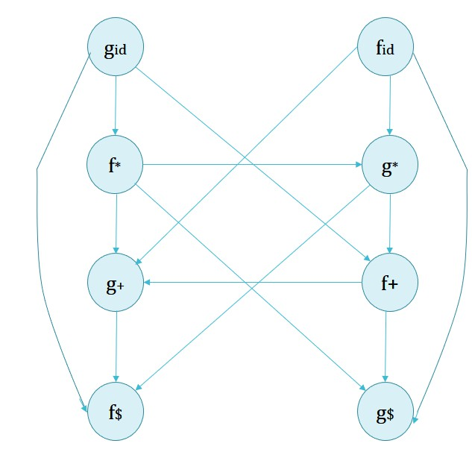
If the constructed graph has an cycle then no precedence function exist. When there are no cycles collect the length of the longest paths from the group of fa and gb respectively.
Precedence function
Now, f | + | * | id | $
g
f | 2 | 4 | 4 | 0
g | 1 | 3 | 5 | 0

Slide 74
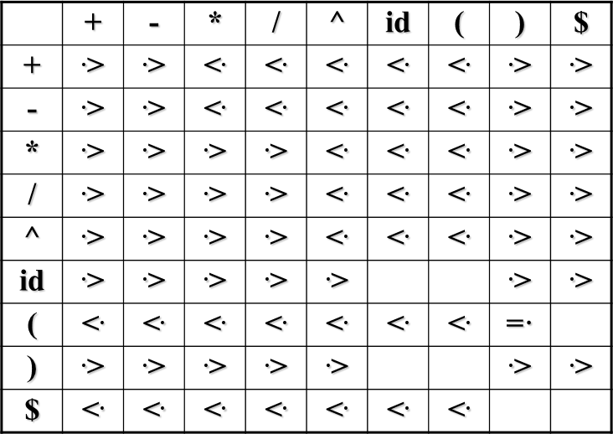
Operator Precedence Parsing

Slide 75
Operator Precedence Parsing
Disadvantages:
Small class of grammars.
Difficult to decide which language is recognized by the grammar.
Advantages:
simple
powerful enough for expressions in programming languages

Slide 76
LR Parsers
This is the most efficient method of the bottom-up parsing which can be used to parse the large class of context free grammars. This method is also called LR parser.
Non backtracking shift reduce technique.
L stands for Left to right scanning
R stands for rightmost derivation in reverse.

Slide 77
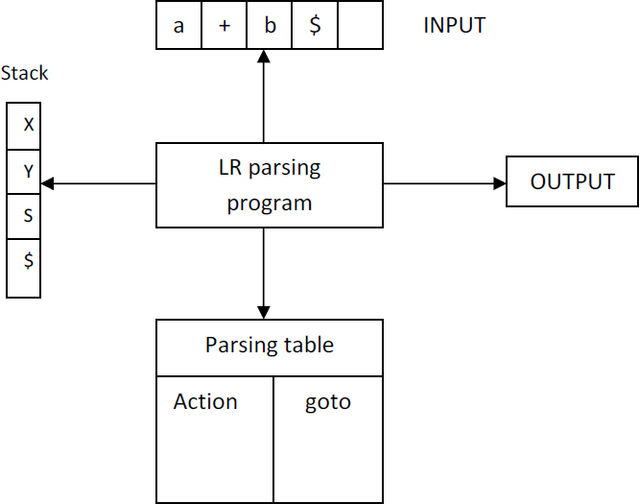
LR Parsers

Slide 78
The structure of LR parser consists of input buffer for storing the input string, a stack for storing the grammar symbols, output and a parsing table comprised of two parts, namely actions and goto.
LR Parsers
There is one parsing program which is actually driving program and reads the input symbol out at a time from the input buffer.
The driving program works on following line.
1. It initializes the stack with start symbol and invokes scanner (lexical analyzer) to get next token.
2. It determines sj the state currently on the top of the stack and ai the current input symbol.
3. It consults the parsing table for the action {sj, ai} which can have one of the values.

Slide 79
i. si means shift state i.
LR Parsers
ii. rj means reduce by rule j.
Accept means Successful parsing is done.
Error indicates syntactical error.

Slide 80
S→ • ABC , S→ A •BC , S→ ABC •
LR(0):- The LR(0) item for grammar G is production rule in which symbol • is inserted at some position in RHS of the rule.
Definitions
Augmented Grammar:- If a grammar G is having start symbol S then augmented grammar is a new grammar G’ in which S’ is a new start symbol such that S’→S. The purpose of this grammar is to indicate the acceptance of input.
Kernel items:- It is collection of items S’→ •S and all the items whose dots are not at the leftmost end of RHS of the rule.
Non kernel items:- The collection of all the items in which • are
at the left end of RHS of the rule.
Functions closure and goto:- These are two important functions required to create collection of canonical set of items.
Viable Prefix:- It is the set of prefixs in the right sentential form of production A→α. This set can appear on the stack during shift/reduce action.

Slide 81
Example:- S→ AA
I2 = goto (I0, A) S → A •A A → •aA
A → •b
=goto (I2, b) same as I4
LR(0) Parser
A→ aA | b
1st Step:-
S’ → S S → AA
A → aA A → b
2nd Step:-
I0 = S’ → • S
S → •AA A → •aA A → •b
I1 = goto (I0 , S)
S’ → S•
I6 = goto (I3, A) A → aA•
I3 = goto (I0, a)
A → a • A A → •a A A → •b
I4 = goto (I0, b) A → b •
I5 = goto (I2, A) S → AA •
=goto (I2, a) same as I3
= goto (I3, a) Same as I3
= goto (I3, b) Same as I4
follow (S') ={$}
FOLLOW(S) = {$} FOLLOW (A) = {a, b, $}

Slide 82
LR(0) Parser
Action | Goto
 | a | b | $ | S | A
0 | S3 | S4 |  | 1 | 2
1 |  |  | Accept
2 | S3 | S4 |  |  | 5
3 | S3 | S4 |  |  | 6
4 | r3 | r3 | r3
5 | r1 | r1 | r1
6 | r2 | r2 | r2

Slide 83
LR(0) Parser
Stack | Input | Action
0 | aabb$
0a3 | abb$ | S3
0a3a3 | bb$ | S3
0a3a3b4 | b$ | S4
0a3a3A6 | b$ | r3
0a3A6 | b$ | r2
0A2 | b$ | r2
0A2b4 | $ | S4
0A2A5 | $ | r3
0S1 | $ | r1
Accept

Slide 84
LR(0)
Disadvantage
In LR(0) the reduction string is in entire row. Therefore, we
have to reduce by taking the decision looking at grammar.
🞄 So, it is not powerful and accurate.

Slide 85
SLR
🞄 SLR means simple LR.
🞄 A grammar for which an SLR parser can be constructed is said to be an SLR.
🞄 SLR is a type of LR parser with small parse tables and a
relatively simple parser generator algorithm.
🞄 The parsing table has two states(action, goto)
🞄 The parsing table has values:
Shift S, where S is a state
Reduce by a grammar production
Accept and
Error

Slide 86
=goto (I2, c) same as I3
=goto (I2, d) same as I4
Example:-
S→ CC
C→ cC | d
1st Step:-
S’ → S S → CC
C→ cC
C→ d
2nd Step:-
I0 = S’ → • S
S → •CC C → •cC C →•d
I1 = goto (I0 , S) S’ → S•
SLR(1)
Parser
I2 = goto (I0, C)
S → C •C
C → •cC C → •d
I3 = goto (I0, c)
C → c • C C → •c C C → •d
I4 = goto (I0, d) C → d•
I6 = goto (I3, C)
C → cC•
= goto (I3, c)
Same as I3
= goto (I3, d) Same as I4
I5 = goto (I2, C) S → CC •

Slide 87
SLR(1)
Parser
Action | Goto
 | c | d | $ | S | C
0 | S3 | S4 |  | 1 | 2
1 |  |  | Accept
2 | S3 | S4 |  |  | 5
3 | S3 | S4 |  |  | 6
4 | r3 | r3 | r3
5 |  |  | r1
6 | r2 | r2 | r2
S’ → S
S → CC
C→ cC
C→ d
Follow: S’ = {$} S = {$}
C = {c,d,$}

Slide 88
SLR(1)
Parser
Stack | Input | Action
0 | dcd$
0d4 | cd$ | S4
0C2 | cd$ | R3
0C2c3 | d$ | S3
0C2c3d4 | $ | S4
0C2c3C6 | $ | R3
0C2C5 | $ | R2
0S1 | $ | R1
Accept

Slide 89
Check whether given grammar is SLR or not.
SLR(1)
Parser
Example 1:
E → E + T | T
T → T * F | F
F → (E) | id
String : id+id*id
Example 2:
S → AaAb
S → BbBa
A → ε
B → ε
Example 3 :
S → L=R
S → R L → *R L → id R → L

Slide 90
I6=goto (I1, +) E →E+•T T → •T*F | •F F →•(E) | •id
I7 = goto (I2, *) T →T*•F F →•(E) | •id
I8 = goto (I4, E) F → (E•) E → E•+T
Example:-
E → E + T | T
T → T * F | F F → (E) | id
1st Step:-
E’ → E
E → E + T | T
T → T * F | F F → (E) | id 2nd Step:- I0 = E’ → •E
E → •E+T | •T
T → •T*F | •F
F →•(E) | •id
I1 = goto (I0, E) E’ → E• E → E•+T
I2 = goto (I0, T) E → T• T → T•*F
I3 = goto (I0, F) T → F•
SLR(1)
Parser
I4 = goto (I0, ( ) F → (•E)
E → •E+T | •T
T → •T*F | •F F →•(E) | •id
I5 = goto (I0, id) F → id•
= goto (I4, T) Same as I2
= goto (I4, F) Same as I3
= goto (I4, ( ) Same as I4

Slide 91
= goto (I4, id)
= goto (I7, id) Same as I5
I11 = goto (I8, ) )
F →(E)•
= goto (I8, +) Same as I6
= goto (I9, * ) Same as I7
I4 = goto (I0, ( ) F → (•E) E → •E+T | •T T → •T*F | •F F →•(E) | •id |  | Same as I5 I9 = goto (I6, T) E → E+T• T → T•*F = goto (I6, F) Same as I3 = goto (I6, ( ) Same as I4 = goto (I6, id ) Same as I5 I10 = goto (I7, F) T → T*F•
I6=goto (I1, +) E →E+•T T → •T*F | •F F →•(E) | •id
I7 = goto (I2, *) T →T*•F F →•(E) | •id
I8 = goto (I4, E) F → (E•) E → E•+T
 |  | = goto (I7, ( ) Same as I4
SLR(1)
Parser
FOLLOW (E’) = {$}
 | FOLLOW (E) = { +,),$ }
 | FOLLOW (T) = { +,*,),$ }
 | FOLLOW (F) = { +,*,),$ }

Slide 92
SLR(1)
Parser
ACTION |  |  |  |  |  |  | GOTO
 | id | + | * | ( | ) | $ | E | T | F
0 | S5 |  |  | S4 |  |  | 1 | 2 | 3
1 |  | S6 |  |  |  | Accept
2 |  | R2 | S7 |  | R2 | R2
3 |  | R4 | R4 |  | R4 | R4
4 | S5 |  |  | S4 |  |  | 8 | 2 | 3
5 |  | R6 | R6 |  | R6 | R6
6 | S5 |  |  | S4 |  |  |  | 9 | 3
7 | S5 |  |  | S4 |  |  |  |  | 10
8 |  | S6 |  |  | S11
9 |  | R1 | S7 |  | R1 | R1
10 |  | R3 | R3 |  | R3 | R3
11 |  | R5 | R5 |  | R5 | R5

Slide 93
I1 = goto (I0, S) S’ → S•
I2 = goto (I0, L) S → L • = R R → L•
I3 = goto (I0, R) S → R•
I4 = goto (I0, * ) L → * • R R → • L L → • * R | • id
I5 = goto (I0, id) L → id•
I7 = goto (I4, R) L → * R•
= goto (I4, *) Same as I4
I8 = goto (I4, L) R → L •
= goto (I4, id) Same as I5
I9= goto (I6, R ) S → L = R•
= goto (I6, L) Same as I8
= goto (I6, *) Same as I4
= goto (I6, id) Same as I5
Example :-
S → L = R | R
L → * R | id R → L
1st Step:-
S’ → S
S → L = R | R
L → * R | id R → L
2nd Step:-
I0 = S’ → •S
S → • L = R | • R
L → • * R | • id
R → • L
SLR(1)
Parser
I6=goto (I2, =) S → L = • R R → • L
L → • * R | • id

Slide 94
Example :- S → AaAb S → BbBa
A → ε
B → ε
1st Step:-
S’ → S
S → AaAb S → BbBa
A → ε
B → ε
2nd Step:-
I0 = S’ → •S
I1 = goto (I0, S)
S’ → S•
I7 = goto (I5, B) S → B b B • a
I8 = goto (I6, b) S → A a A b •
I9 = goto (I7, a) S → B b B a •
SLR(1)
Parser
I2 = goto (I0, A)
S → A • a A b
I3 = goto (I0, B) S → B • b B a
I4 = goto (I2, a ) S → A a • A b A → •
I5 = goto (I3, b) S → B b • B a B → •
FOLLOW (S’) = {$}
FOLLOW (S) = {$}
FOLLOW (A) = {a,b}
FOLLOW (B) = {a,b}
I6= goto (I4, A) S → A a A • b
S → • AaAb | • BbBa
A → •
B → •

Slide 95
SLR(1)
Parser
ACTION |  |  |  | GOTO
 | a | b | $ | S | A | B
0 | R3/R4 | R3/R4 |  | 1 | 2 | 3
1 |  |  | Accept
2 | S4
3 |  | S5
4 | R3 | R3 |  |  | 6
5 | R4 | R4 |  |  |  | 7
6 |  | S8
7 | S9
8 |  |  | R1
9 |  |  | R2

Slide 96
🞄 CLR(1) Parsing configurations have the general form:
🞄 Canonical LR(1) parser.
CLR(1)
🞄 The Look Ahead Component ‘a’ represents a possible look- ahead after the entire right-hand side has been matched.
🞄 CLR parser is the most powerful parser.
LR(1) item = LR(0) item + lookahead
LR(0) Item …. A → α • β LR(1) Item …. A → α • β , a
In LR(1) “a” is lookahead symbol
A → α • Bβ , a FIRST(β , a)

Slide 97
I2 = goto (I0, C)
S → C •C, $ C → •aC, $ C → •d, $
I3 = goto (I0, a)
I7=goto(I2, d) C →d•, $
I8 = goto (I3, C) C → aC•, a/d goto (I3, a)
= same as I3
goto (I3, d)
= same as I4
Example:-
S→ CC
C→ aC | d
1st Step:-
S’ → S S → CC
C→ aC C→ d
2nd Step:-
I0 = S’ → • S, $ S → •CC, $
C → •aC , a/d C →•d, a/d
I1 = goto (I0 , S) S’ → S•,$
CLR(1)
Parser
C → a • C, a/d C → •a C, a/d C → •d, a/d
I4 = goto (I0, d)
C → d•, a/d
I5 = goto (I2, C) S → CC •, $
I9 = goto (I6, C) C → aC•, $
goto (I6, a) = Same as I6
goto (I6, d) = Same as I7
I6 = goto (I2,a ) C → a•C, $ C → •aC,$ C → •d,$

Slide 98
CLR(1)
Parser
Action | Goto
 | a | d | $ | S | C
0 | S3 | S4 |  | 1 | 2
1 |  |  | Accept
2 | S6 | S7 |  |  | 5
3 | S3 | S4 |  |  | 8
4 | r3 | r3
5 |  |  | r1
6 | S6 | S7 |  |  | 9
7 |  |  | r3
8 | r2 | r2
9 |  |  | r2
Reduce entry only in the lookahead.

Slide 99
CLR(1)
Parser
Stack | Input | Action
0 | aadd$
0a3 | add$ | S3
0a3a3 | dd$ | S3
0a3a3d4 | d$ | S4
0a3a3C8 | d$ | R3
0a3C8 | d$ | R2
0C2 | d$ | R2
0C2d7 | $ | S7
0C2C5 | $ | R3
0S1 | $ | R1
Accept

Slide 100
🞄 Example:- S → L = R | R
L → * R | id R → L
CLR(1)
Parse String : *id=id

Slide 101
LALR(1)
🞄 In this type of grammar the lookahead symbol is generated for each set of item. The table obtained by this method are smaller compared to clr(1) parser.
🞄 In fact the state of LALR(Look Ahead LR) and SLR are always same.
🞄 We follow the same steps as discussed in SLR and canonical LR
parsing techniques and those are:
Construction of canonical set of items along with look ahead.
Building LALR parsing table.
Parsing the input string using canonical LR parsing table.
NOTE :
🞄 No. of Item State in SLR = No. of Item State in LALR < No. of state in CLR
🞄 CLR is most powerful among all LR Parsers.

Slide 102
I2 = goto (I0, C)
S → C •C, $ C → •aC, $ C → •d, $
I3 = goto (I0, a)
I7=goto(I2, d) C →d•, $
I8 = goto (I3, C) C → aC•, a/d goto (I3, a)
= same as I3
goto (I3, d)
= same as I4
Example:-
S→ CC
C→ aC | d
1st Step:-
S’ → S S → CC
C→ aC C→ d
2nd Step:-
I0 = S’ → • S, $ S → •CC, $
C → •aC , a/d C →•d, a/d
I1 = goto (I0 , S) S’ → S•,$
LALR(1)
Parser
C → a • C, a/d C → •a C, a/d C → •d, a/d
I4 = goto (I0, d)
C → d•, a/d
I5 = goto (I2, C) S → CC •, $
I9 = goto (I6, C) C → aC•, $
goto (I6, a) = Same as I6
goto (I6, d) = Same as I7
I6 = goto (I2,a ) C → a•C, $ C → •aC,$ C → •d,$

Slide 103
CLR(1)
Parser
Action | Goto
 | a | d | $ | S | C
0 | S3 | S4 |  | 1 | 2
1 |  |  | Accept
2 | S6 | S7 |  |  | 5
3 | S3 | S4 |  |  | 8
4 | r3 | r3
5 |  |  | r1
6 | S6 | S7 |  |  | 9
7 |  |  | r3
8 | r2 | r2
9 |  |  | r2
Reduce entry only in the lookahead.

Slide 104
LALR(1)
Parser
Action | Goto
 | a | d | $ | S | C
0 | S36 | S47 |  | 1 | 2
1 |  |  | Accept
2 | S36 | S47 |  |  | 5
36 | S36 | S47 |  |  | 89
47 | r3 | r3 | r3
5 |  |  | r1
89 | r2 | r2 | r2
Reduce entry only in the lookahead.

Slide 105
LALR(1)
Parser
Stack | Input | Action
0 | aadd$
0a36 | add$ | S36
0a36a36 | dd$ | S36
0a36a36d47 | d$ | S47
0a36a36C89 | d$ | R3
0a36C89 | d$ | R2
0C2 | d$ | R2
0C2d47 | $ | S47
0C2C5 | $ | R3
0S1 | $ | R1
Accept

Slide 106
LALR(1)
Parser
Example:- S→Aa S→bAc S→dc S→bda A→d
In above
example no state are having common
production rule. Hence no states can be merged, so generate LALR(1) Parsing table for all given states.

Slide 107


